Slide 1
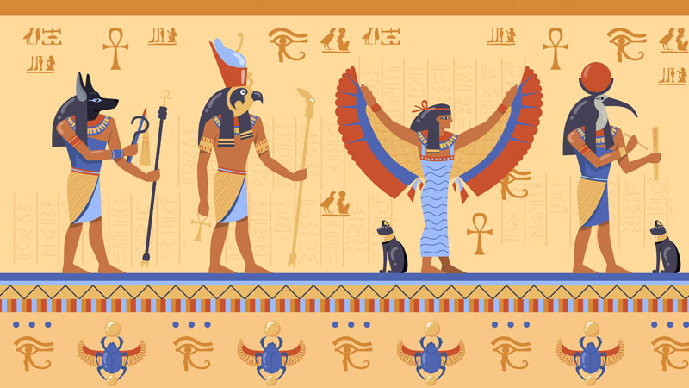
Economic/Military Structures
GOAL/S: Describe Ancient Egyptian Economic/Military Structures
Week 9, Lesson 3

Slide 2
Ancient Egypt – This week
Social/Political Structures
Economic Structures
(AND MILITARY)
Religious/Cultural Structures

Slide 3
The Economy
land was assessed and taxed (produce)
taxes assessed by flood levels
better years = more tax, drier years = less tax
people conscripted to work during inundation
labour force required for projects (e.g. temples/pyramids)

Slide 4
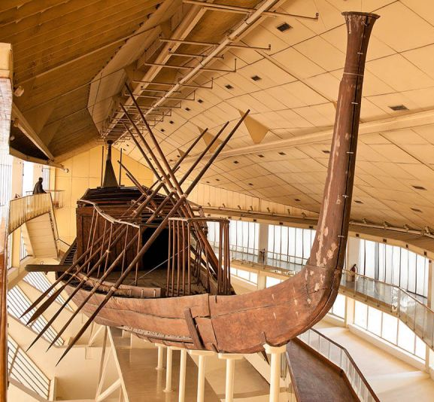
The Nile River was a highway. It linked and united communities – so much so, that no wheels were used in Egypt for thousands of years (until 1600 BCE). The River current and winds flow in opposite directions – the current runs South to North, and the wind runs North to South. This made it easy to travel around Egypt.
Cedar boat from the pyramid of Khufu c. 2500 BCE

Slide 5
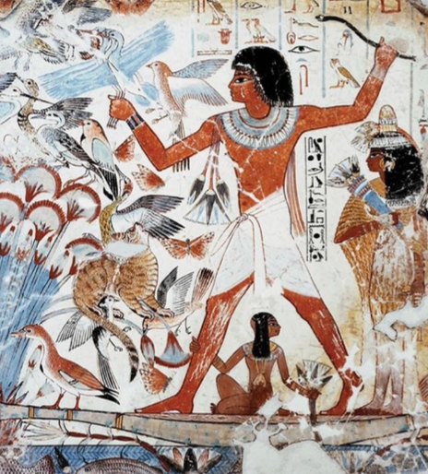
Building, Arts, Crafts
The rich soils, swamps and marshes appear everywhere in Egyptian art.
The desert provided resources for sacred buildings and funerary equipment
The Nile mud was used to make bricks for domestic homes and palaces
The limestone and sandstone from the desert cliffs were used in temples and tombs. Black granite was brought from Aswan to build obelisks, gateways, columns and sarcophagi

Slide 6
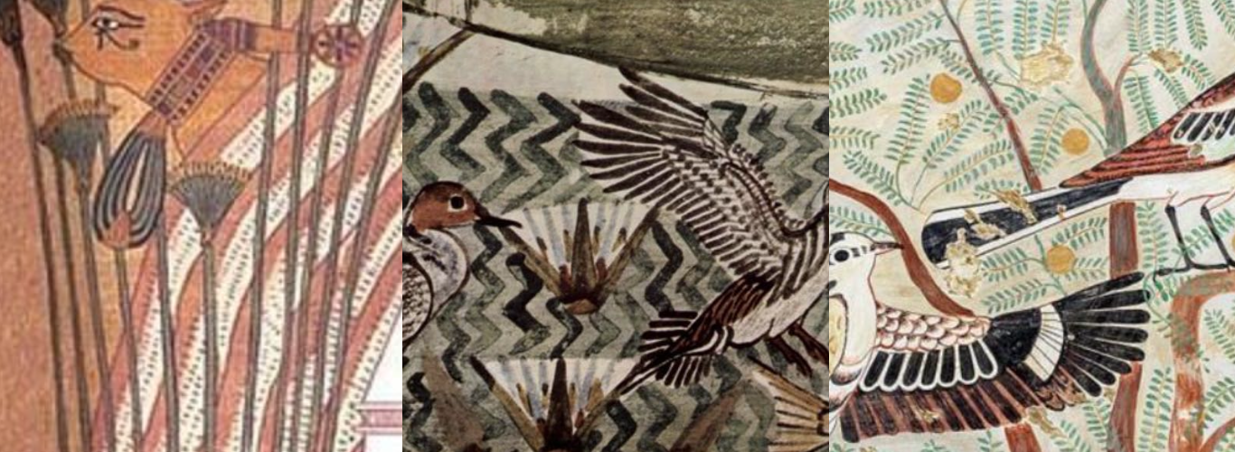
The river is the main motif in all Egyptian decoration

Slide 7
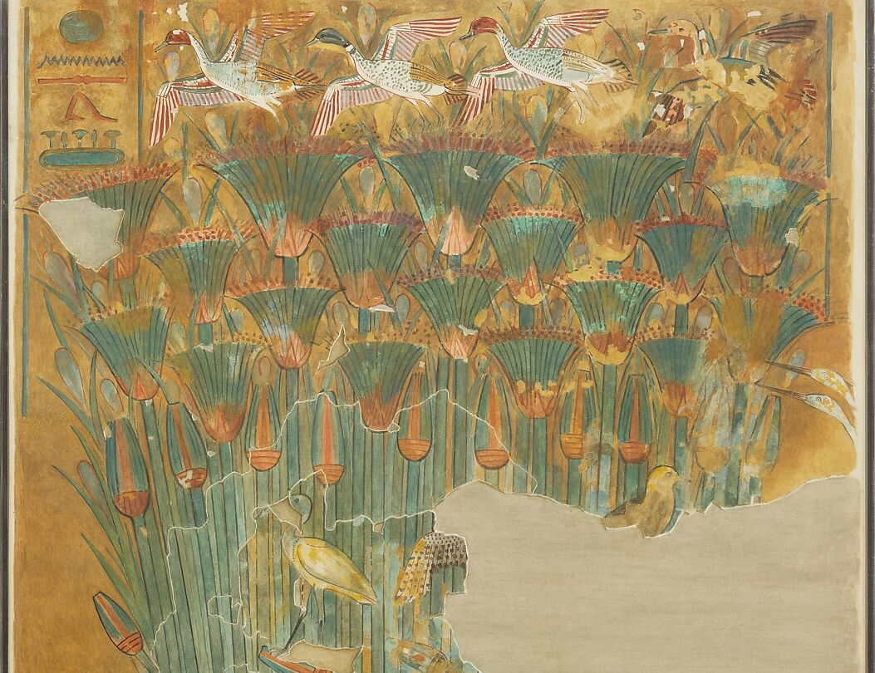
Papyrus
grows widely across the swamps and marshes of the River delta
Sandals, boats, raps, baskets, paper

Slide 8
The Deserts provided precious minerals.
These were used in everything from statues to jewellery, jars, lamps, and cups

Slide 9
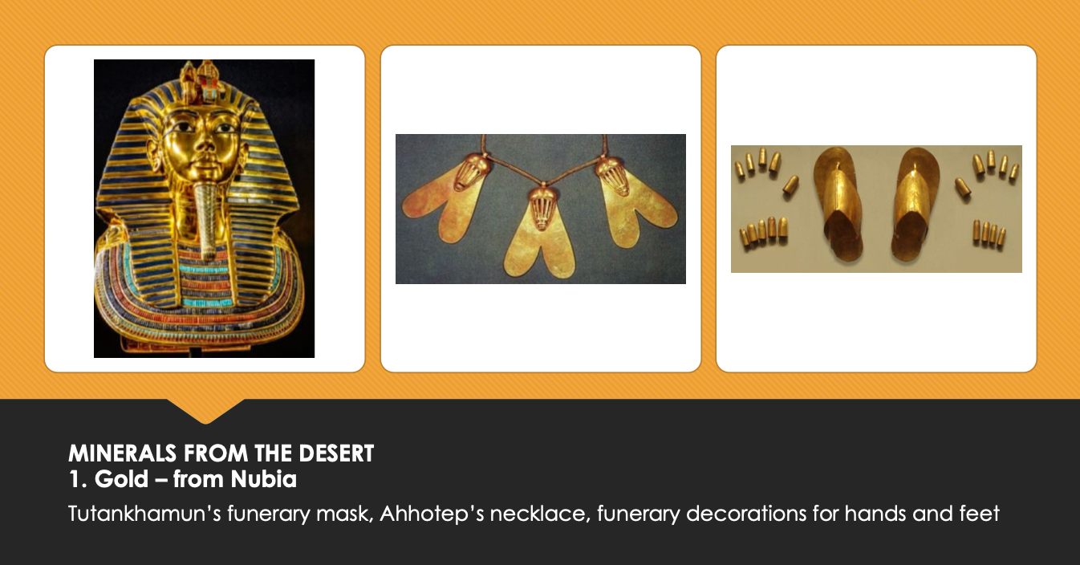

Slide 10
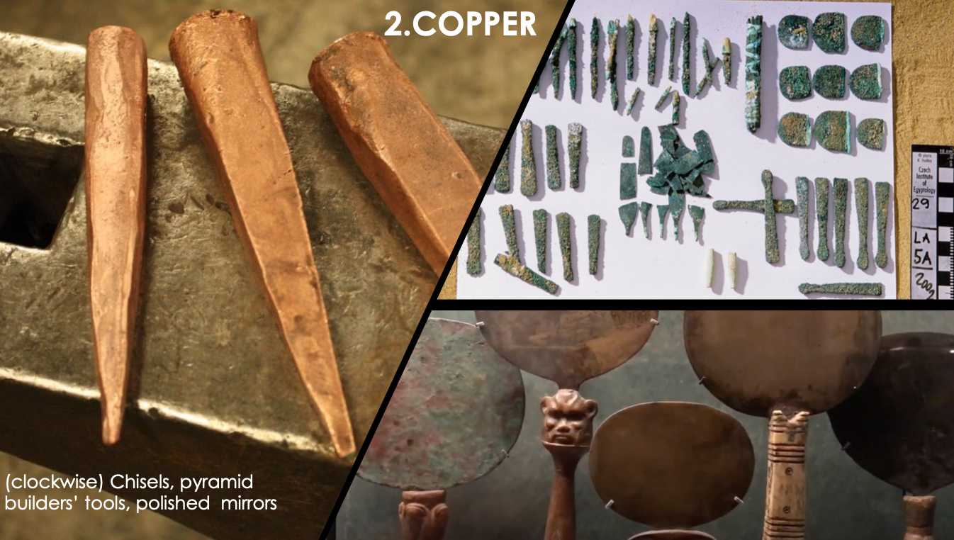

Slide 11
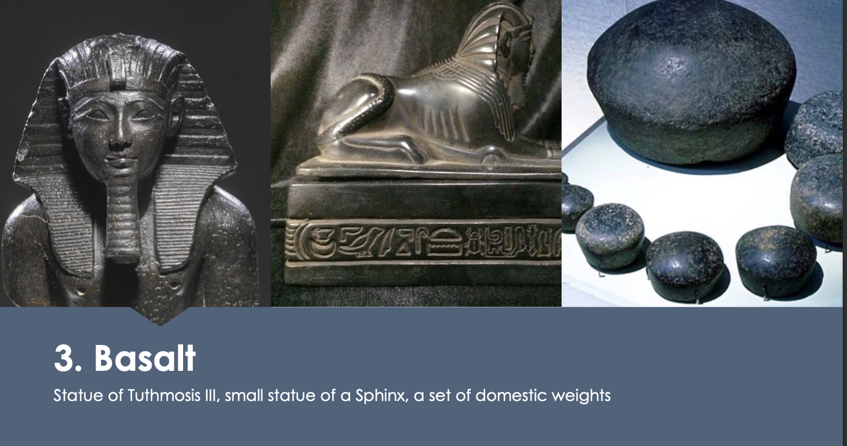

Slide 12
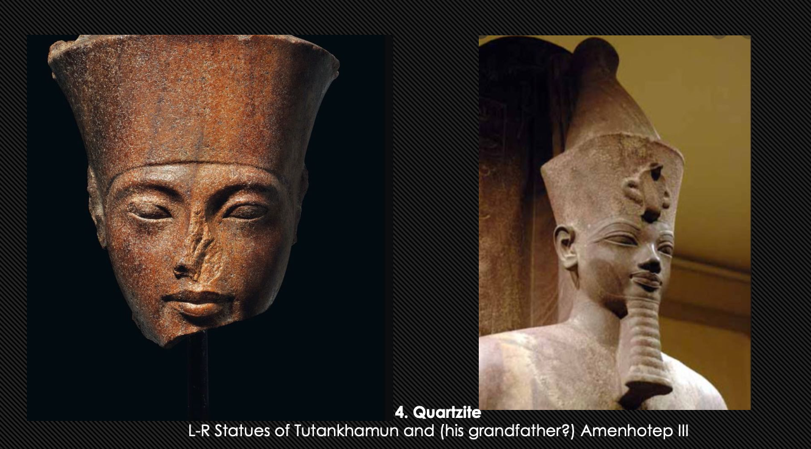

Slide 13
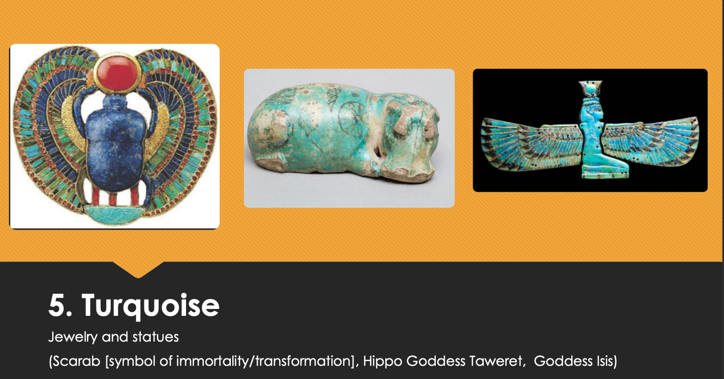

Slide 14
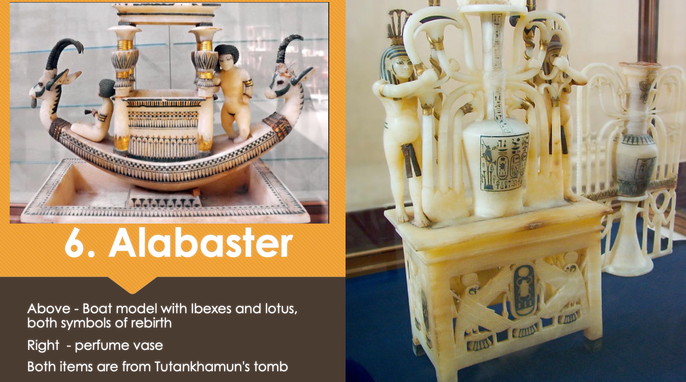

Slide 15

ACTIVITY – Ancient Egyptian Warfare
Read through the information sheet about ‘Ancient Egyptian Warfare’
Complete the activity sheet provided
Submit by the end of the lesson

